Slide 1
Philips MRI spiral reconstruction problem
By Emiel Hartsema
K.E.Hartsema@student.tudelft.nl

Slide 2
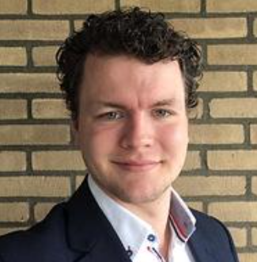
Emiel Hartsema
Master project applied physics TU Delft
Working on advanced reconstruction algorithm for multicomponent magnetic fingerprinting
Email: K.E.Hartsema@student.tudelft.nl

Slide 3
Code on github
A python notebook has been uploaded to my github to show code used.
Link to github: https://github.com/EmielHartsema/philips-reconstruction-problem/blob/main/Philips%20spiral%20MRI%20problem.ipynb

Slide 4
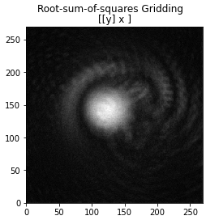
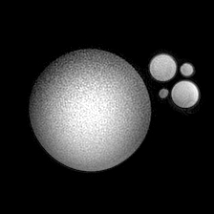
Reconstruction algorithm
To test, I made a simple reonstruction algorithm, same as shown in sigpy turotial [1]
Dicom image supplied with dataset
[1] https://github.com/mikgroup/sigpy-mri-tutorial/blob/master/01-gridding-reconstruction.ipynb

Slide 5
Reading kspace data
Data read from datafile with matlab script
Output format is as expected (i.e. correct num of coils, num images, num datapoints per spiral, num spirals per image)
Python version gives exactly same resulting complex matrix
Reading kspace data does not seem to be the problem

Slide 6
Generating kspace coordinates
Parameters used (as given in settings file)
FOV: 208 mm
spirals per image = 48;
acq. window (ms) = 5.0;
spiral direction = "spiral out";
variable density = No
Sampling tau calculated from acq window and #samples (1210).
5/1210 = 0.00413223
Oversampling ratio = 1
Spiral variable frequency scale – CSC parameter = 3.0

Slide 7
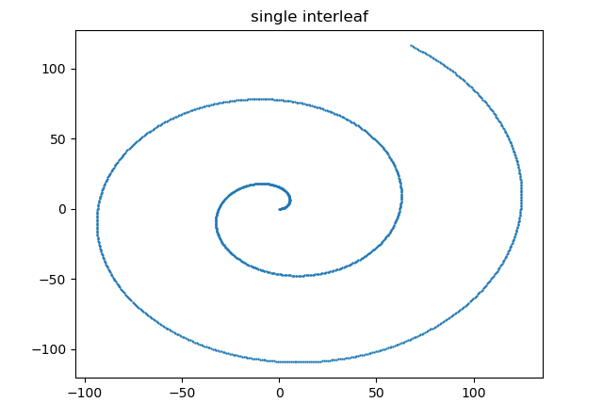
Generating kspace coordinates
Interleaf generated with spiralblur2018.py (Code on github [1])
Interleafs are rotated 2pi/48 * ky (counter clock wise)
ky from the .list file [0,1,2,…,47]
First interleaf starts in +x direction
[1] https://github.com/EmielHartsema/philips-reconstruction-problem/blob/main/Philips%20spiral%20MRI%20problem.ipynb

Slide 8
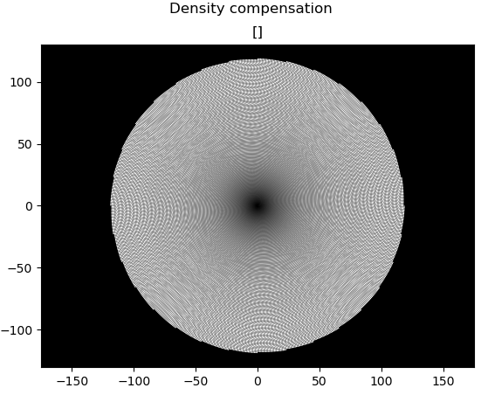
Density compensation
Density compensation based on a paper linked below
Hoge, R. D., Kwan, R. K. S., & Pike, G. B. (1997). Density compensation functions for spiral MRI. Magnetic Resonance in Medicine, 38(1), 117–128. https://doi.org/10.1002/mrm.1910380117

Slide 9
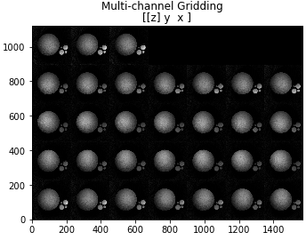
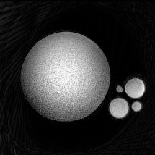
Reconstrucion of simulated data
Data simulated with spiral coordinates
Works well, density compensation seems to be correct.
Single coil images
Original
Reconstruction

Slide 10
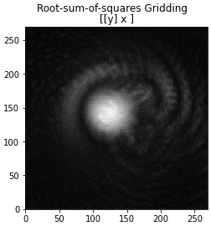
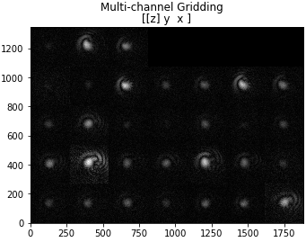
Reconstrucion of real data
No phantom is visible, even in the single coil images.
Root sum square of coil images
Single coil images

Slide 11
NUFFT
Because the error is already present in the single coil images, the input to the NUFFT must be incorrect.
K-space data has been calculated in two independent ways, so is probably correct
Oversampling ratio stated to be 1 in file.
Coordinates: unsure

Slide 13
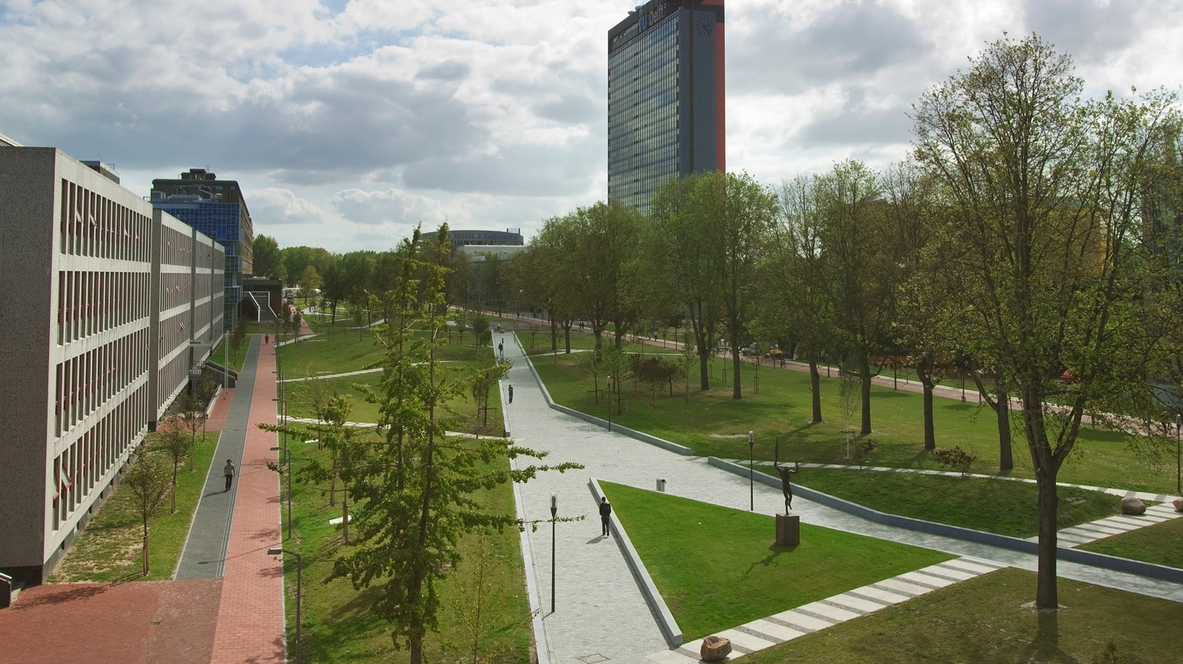
Insert a picture

Slide 14
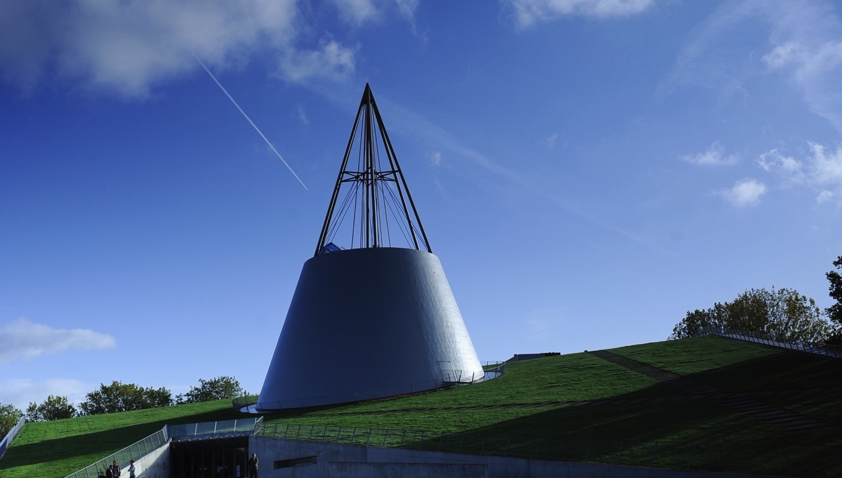
Insert a picture

